Slide 1
Drchrono: Check-in Kiosk
http://localhost:8000/
Author: Jingya Xu
Email: xujingyastan@gmail.com

Slide 2
Overview
Key Features
OUTLINE
Feature implementation
Future work

Slide 3
Overview: requirements
Picture going to the doctor's office and replacing the receptionist and paper forms with a kiosk similar to checking in for a flight.
1. Doctor should be able to setup Kiosk for their office using Drchrono account.
2. Patient can check-in and update their demographic information.
3. Once patient have update information, set the appointment status to "Arrived".
4. Doctor can manage appointments after they login.
5. Doctor should be able to see patient current waiting time and average waiting time of his appointments.

Slide 4
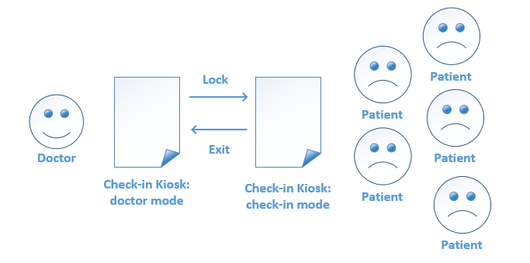
Overview
Fig. 1 Check-in Kiosk system usage for one doctor

Slide 5
Key features
Register: install app in drchrono.com

Slide 6
Key features
Mode control: only doctor can set device to check-in mode and exit.

Slide 7
Key features
Patient can update demographic information and skip updating.

Slide 8
Key features
Appointment: every appointment card has a link to appointment detail on drchrono.

Slide 9
Key features
Appointment: sync function.

Slide 10
Key features
Appointment: card color varies according to appointment status.

Slide 11
Key features
Appointment: doctor can see newly arrived patient when patient check-in. (ajax)

Slide 12
Key features
Appointment: doctor can see average waiting time in history and can see arrived patients’ waiting time in real-time.

Slide 13
Key features
All deletion should are confirmed.

Slide 14
Key features
Form validation.

Slide 15
Future work
Automatically update local appointment data base when adding or deleting appointment in drchrono, instead of doing sync by doctor.

Slide 16
Future work
When user is not oauthed, he/she will get an authentication page to do oauth.

Slide 17
THANKS

